Slide 1
Kafka Monitoring System
Team
405 Found

Slide 2
Problem Statement
Producer Rate
Consumption Rate
Lag

Slide 3
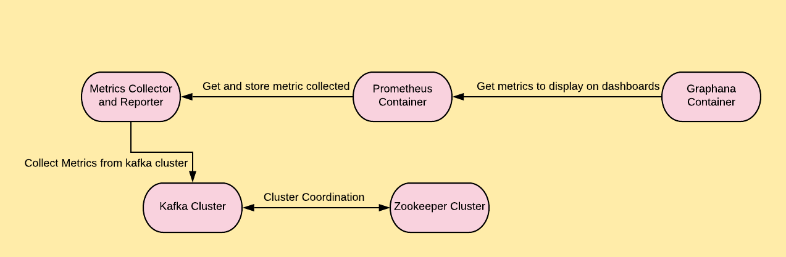
Design Flow

Slide 4
Metrics Collector and Reporter
KafkaMetricsExporter and JMX Exporter will collect broker metrics from Kafka cluster.
Implemented by expanding Kafka admin client.
Exposes the metric detail using the Prometheus Collector Registry.
Notes:
Metrics Reporter
Implemented by expanding Kafka admin Client.
Exposes the metric detail using the Prometheus Collector Registry.

Slide 5
Prometheus
Configured to connect to Metrics Reporter at a specified time Interval.
Pulls and stores the time series data.
Has inbuilt query to extract data.
Notes:
Prometheus
Configured to connect to the Metrics Reporter at a specified time interval.
Pulls and stores the time series data.
Has inbuilt query to extract the data.

Slide 6
Grafana
Allows you to query, analyze, visualize and alert the metrics.
Notes:
Grafana
Allows you to query, Visualize , alert your metrics.

Slide 7
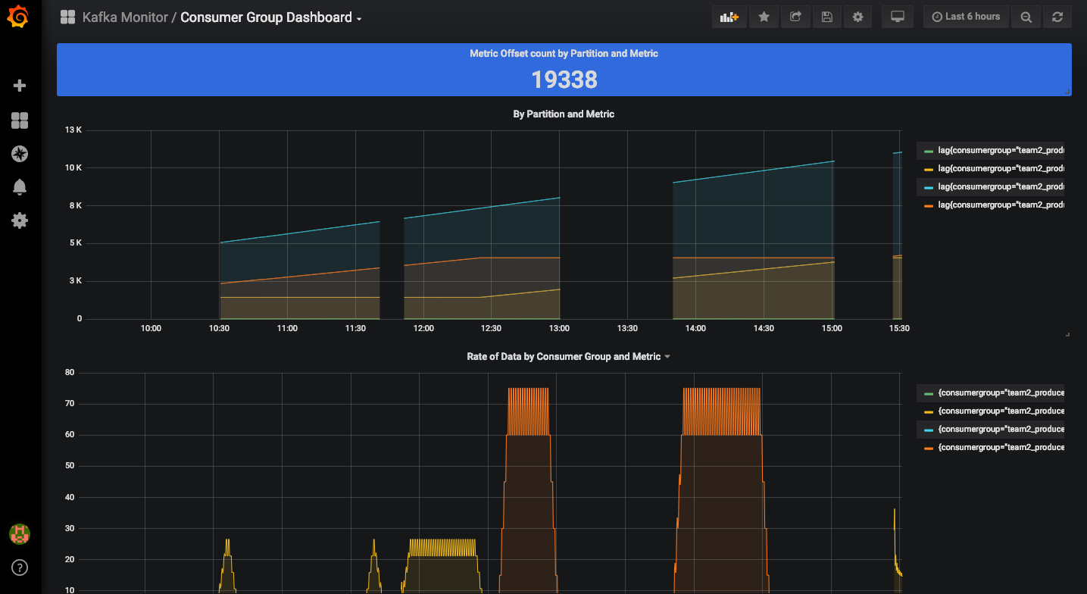
Consumer Group Dashboard
Consumer group dashboard allows us to visualize Producer/consumer offset and lag grouped by consumer group.

Slide 8
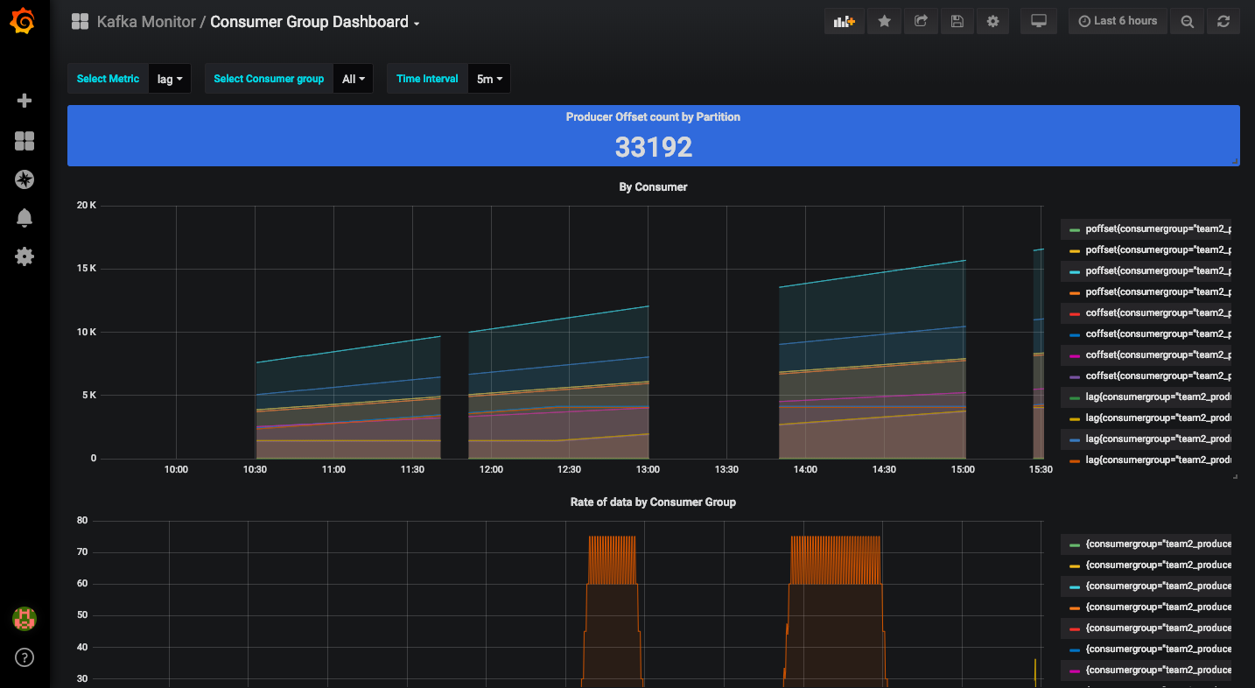
Consumer Group Dashboard

Slide 9
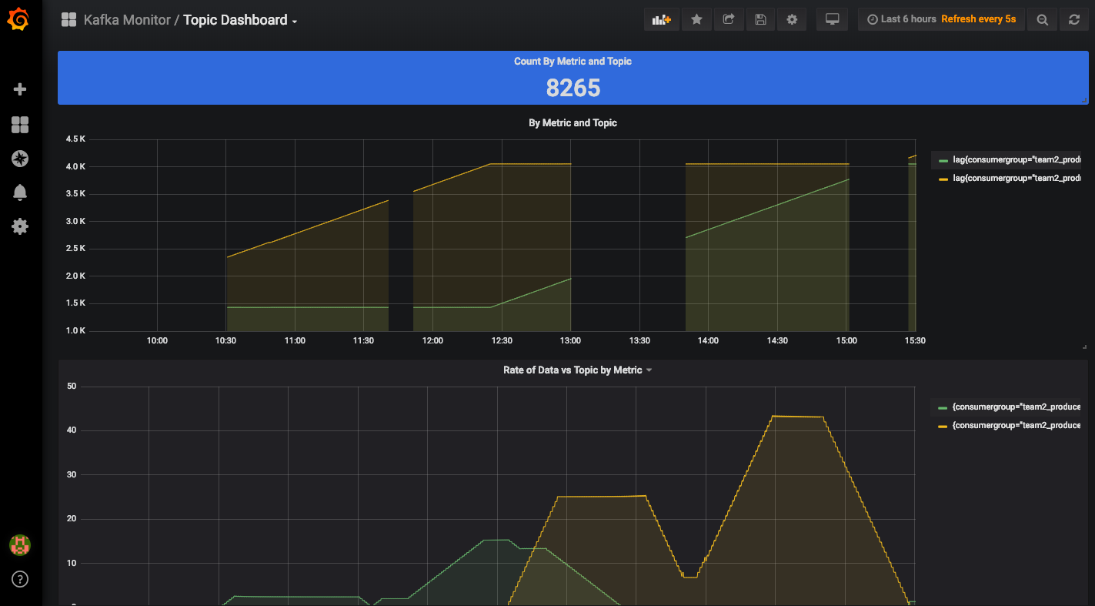
Topic Dashboard
Topic dashboard allows us to visualize Producer/consumer offset and lag with various visualization options filtered by topic.

Slide 10
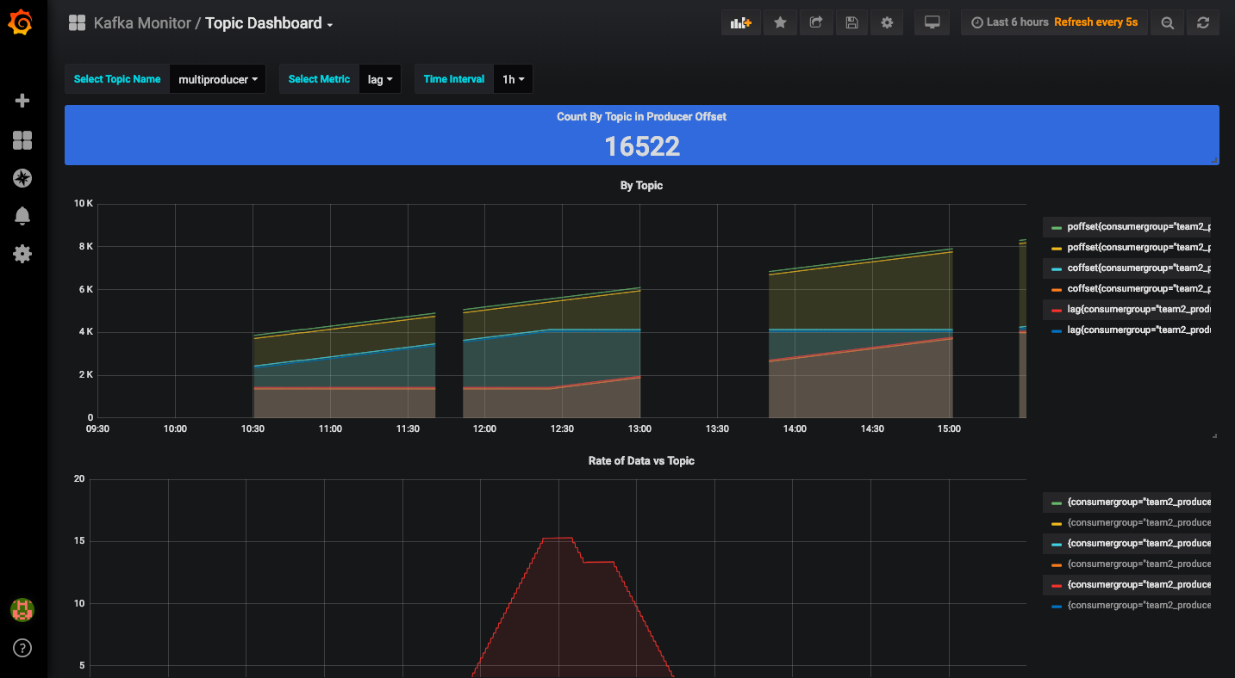
Topic Dashboard

Slide 11
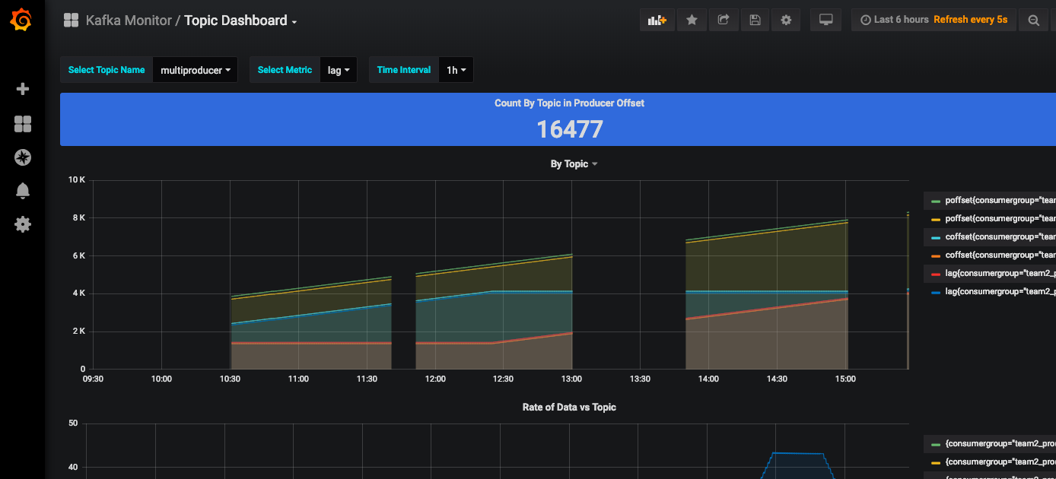
Topic Dashboard

Slide 12
Future Enhancements
Alert Management
Broker Level Metrics Visualization

Slide 13


